Slide 1
novelnest

Slide 2
Team members
Manoj Rathinam – 20MIS1010
Sathiyamathi V – 20MIS1159

Slide 3
Problem statement
In the digital age, readers face challenges in discovering engaging stories amidst an overwhelming abundance of content, compounded by time constraints. Existing platforms lack efficient summarization tools, hindering users' ability to explore diverse narratives. Our project addresses this by leveraging GPT-based summarization technology to provide users with concise story summaries, complemented by personalized recommendations and intuitive interfaces. By streamlining content discovery and enhancing user engagement, we aim to revolutionize the way readers interact with literary works online.

Slide 4
Literature survey

Slide 5
TitleC | Journal name and year | Methodology | Dataset | Tools used | Advantages | Drawbacks
Artificial Intelligence for Automatic Text Summarization | 2018 IEEE International Conference on Information Reuse and Integration for Data Science | Text summarization methods such as topic and indicator representation with TF*IDF and machine learning for sentence selection. It employs various AI techniques, including statistical, machine learning, and deep learning, for generating accurate candidate titles, evaluated using ROUGE scores for performance assessment. | 50,387 essays obtained from the WOS database spanning the years 1970 to 2017 | LIBSVM -- A Library for Support Vector Machines | Provides a novel way to address the challenge of generating titles using AI. The comparison of the accuracy of different deep learning models and the evaluation of performance using ROUGE contribute to the advancement of text summarization methodologies. | This paper include limitations in the fluency of generated candidate titles. This could impact the overall coherence and readability of the titles produced by the models

Slide 6
Title | Journal name and year | Methodology | Dataset | Tools used | Advantages | Drawbacks
Deep Extractive Text Summarization | International Conference on Computational Intelligence and Data Science 2019 | Uses ML and statistical methods like TF*IDF and graphs for summarization, relying on human evaluation due to scarce gold standard data. Employs neural networks to automatically extract features for summarization, needing human input for evaluation owing to dataset limitations. | The paper evaluates extractive text summarization techniques using the Para Multiling 2015 dataset, featuring 40 languages with human-generated summaries, primarily focusing on Indian languages like English, Malayalam, and Hindi. | NLTK - Natural Language Toolkit, TensorFlow and PyTorch | The paper's focus on Indian languages, comprehensive evaluation dataset, holistic coverage of methodologies, and attention to automatic feature extraction contribute significantly to advancing extractive summarization techniques, especially for diverse linguistic contexts like Indian languages. | The paper's drawbacks include heavy reliance on human intervention for evaluation, scarcity of gold standard datasets, oversimplification of summarization criteria, and mixed evaluation outcomes, calling for further refinement in extractive text summarization research.

Slide 7
Title | Journal name and year | Methodology | Dataset | Tools used | Advantages | Drawbacks
Automatic Text Summarization Using a Machine Learning Approach | Advances in Artificial Intelligence, 16th Brazilian Symposium on Artificial Intelligence 2020 | The paper presents a trainable text summarization framework utilizing both statistical and linguistic methodologies, employing Naive Bayes and C4.5 algorithms, demonstrating superior performance with Naive Bayes, and suggesting potential advancements in text summarization algorithms. | The paper utilizes a subset of the TIPSTER document base, containing texts from computer-related magazines | TensorFlow, Keraas, Numpy, Pandas. | The paper offers a comprehensive approach to text summarization, comparing Naive Bayes and C4.5 algorithms, demonstrating experimental rigor, and suggesting avenues for future research, contributing significantly to the field. | The paper's potential drawbacks include limited exploration of summarization techniques, lack of comparison with state-of-the-art methods, dependency on explicit reference summaries, simplistic evaluation metrics, and limited dataset description, which could affect the method's credibility and applicability.

Slide 8
Title | Journal name and year | Methodology | Dataset | Tools used | Advantages | Drawbacks
Text Summarization using Neural Networks | 2019 International Conference on Advances in Computing, Communication and Control | The paper explores various methods in text summarization, including tree-based, ontology-based, rule-based, graph-based, and information item-based approaches, as well as semantic text representation models and abstractive techniques like RNNs and NLG/NLP. | The paper used bucketed dataset sampling to reduce padding, trained a Seq2Seq model with TensorFlow v1.1 using batch size 80, dictionary size 30,000, and embedding size 200, over 300,000 iterations, implementing fixed-size inputs through bucketing for improved results. | (NLP) and machine learning/deep learning algorithms | Efficient, balanced model combines extractive and abstractive methods with advanced techniques for focused, scalable text summarization, incorporating attention mechanisms for enhanced quality. | Challenges include complexities of abstractive summarization, human interpretation issues, reliance on advanced techniques, training dependency, scalability concerns, and potential overreliance on technology, highlighting areas for further refinement.

Slide 9
Title | Journal name and year | Methodology | Dataset | Tools used | Advantages | Drawbacks
Abstractive Text Summarization Using Transformer Based Approach | International Journal of Scientific Research in Engineering and Management 2023 | The paper examines extractive and abstractive methods, transformer-based models like T5, structured and semantic approaches, and comparative evaluations for text summarization. | The paper utilizes the CNN DailyMail Dataset, consisting of 300,000+ news stories divided into training, testing, and validation sets, for training the T5 model and evaluating summarization quality using Rouge Score. | TensorFlow-based T5 model, web frameworks like Flask or Django for REST API, and database management systems for text summarization without explicitly listing all software tools. | The paper highlights the effectiveness of transformer-based models for abstractive summarization, rigorously evaluates performance with ROUGE scores, suggests hybrid model integration, explores diverse data sources like social media, offers future directions, and efficiently uses the CNN DailyMail Dataset, advancing text summarization research. | The paper lacks detailed software information, comprehensive dataset discussion, comparative analysis, model limitations, and future directions, limiting its replicability and impact in text summarization research.

Slide 10
Title | Journal name and year | Methodology | Dataset | Tools used | Advantages | Drawbacks
Convolutional Neural Network based for Automatic Text Summarization | International Journal of Advanced Computer Science and Applications, 2019 | The paper outlines a comprehensive methodology encompassing data selection, preparation, and exploration of various Automatic Text Summarization techniques, focusing on natural disaster-related document sets from the DUC collection. | The paper utilizes the DUC2002 dataset, focusing on natural disaster reports, and employs meticulous data preparation techniques, including stop word removal and stemming, to optimize input for summarization models. | ROUGE toolkit | The paper presents an innovative CNN-based Automatic Text Summarization (ATS) system, rigorously tested with 26 configurations, showcasing improved quality and utilizing the standard DUC2002 dataset, fostering interdisciplinary relevance in the field.. | The paper lacks detailed discussion on method limitations, potentially hindering a balanced evaluation, and it could benefit from addressing challenges in constructing experimental benchmarks and using deep convolutional networks. Additionally, reliance on a single dataset may limit generalizability, and it's essential to acknowledge practical/theoretical drawbacks for a comprehensive assessment.

Slide 11
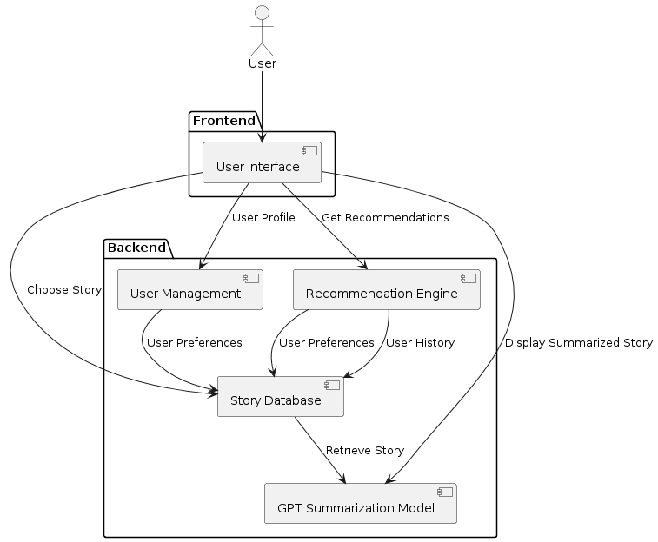
Architecture flow diagram

Slide 12
modules
User Interface Module
Story Database
Summarization module
Recommendation module

Slide 13
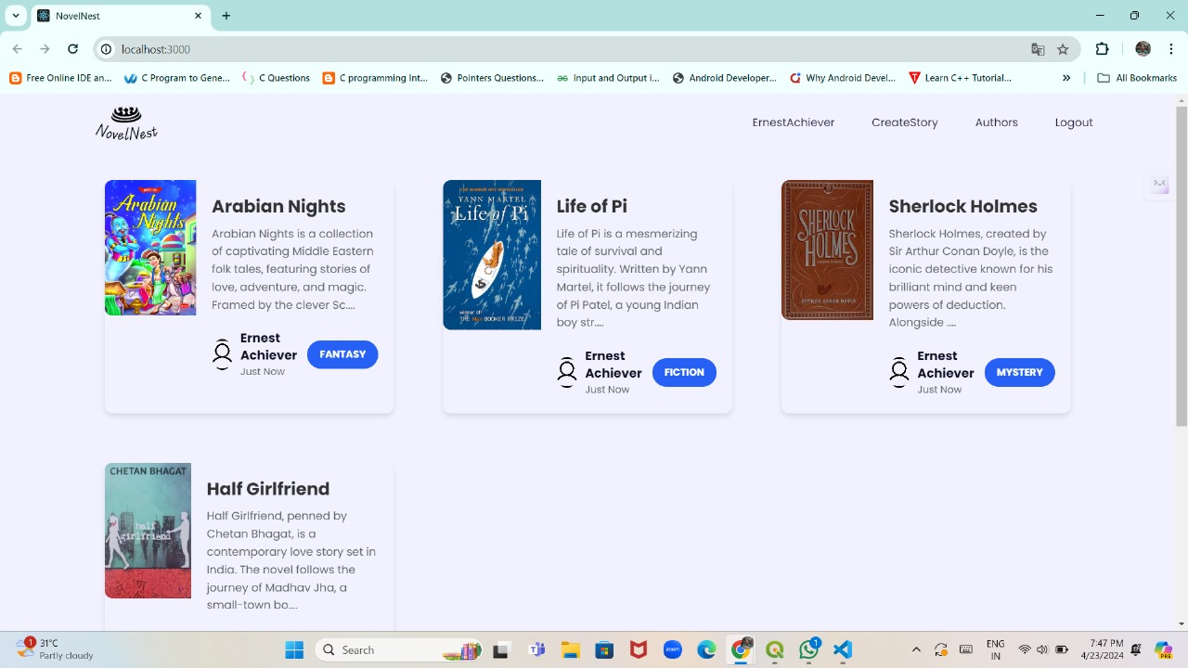
output

Slide 14
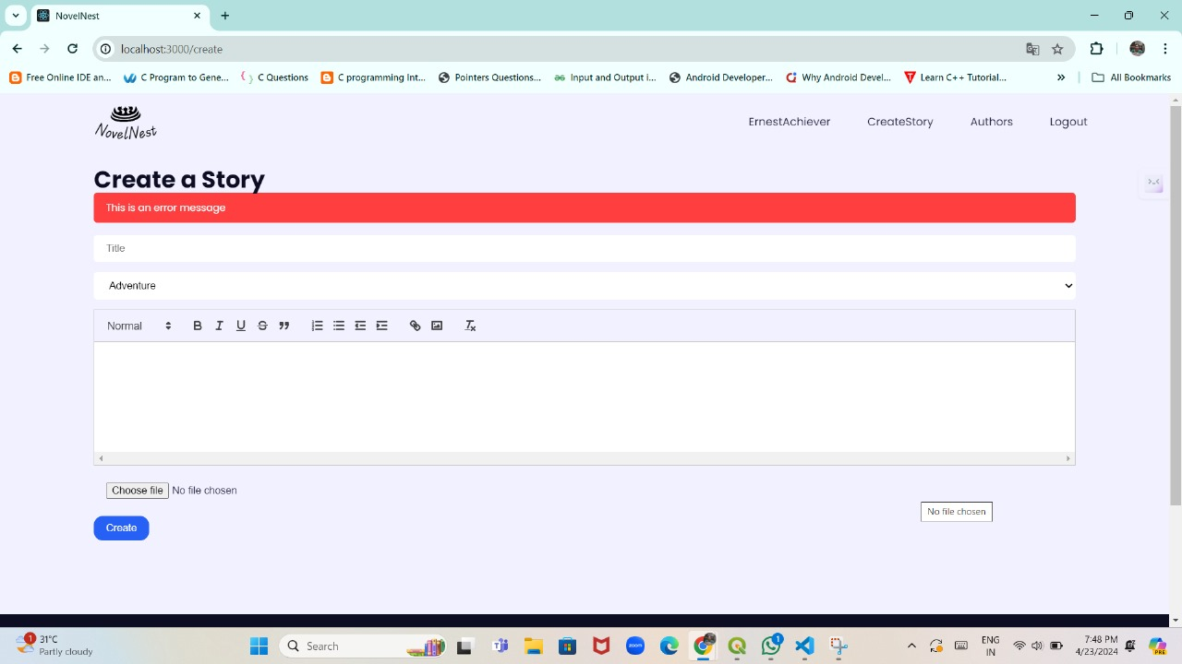
output

Slide 15
References
1.https://www.researchgate.net/publication/371970897_Automated_Article_Summarization_using_Artificial_Intelligence_Using_React_JS_and_Generative_AI
2.https://www.sciencedirect.com/science/article/pii/S1319157820303712
3.https://www.sciencedirect.com/science/article/pii/S1877050920306566
4.https://www.researchgate.net/publication/355744496_Text_Summarization_of_an_Article_Extracted_from_Wikipedia_Using_NLTK_Library
5. https://ieeexplore.ieee.org/abstract/document/9036739

